Slide 1
PRESENTATION INTERVISION TRADING RO SRL

Slide 2
Historic
Established in March 1996, INTERVISION TRADING started its retail electronics business with its own shop in the center of Pitesti.
In the coming years, the network was developed step by step, and as of 2005, the company owns 4 stores, adding in the range, household appliances, IT, etc.

Slide 3
beginnings
Since 1997, the company has started its own imports of electronic products, starting from the United Arab Emirates, following Singapore since 1999 (with multi-branded products such as SONY, PANASONIC, SAMSUNG, LG, PHILIPS, DAEWOO, etc.) and China-Hong Kong since 2002 (products under its own INTERVISION brand), imports made to cover the needs of its own stores as well as for distribution to customers from all over the country.

Slide 4

Company development
Between 2000-2005, INTERVISION was the sole distributor of the ENZER brand in Singapore (audio-video products).
In 2007, the negotiations for the exclusive distribution of the AKAI brand in Romania were finalized, activity started in 2008, with the strong development of the Romanian distribution and the signing of the first contracts with key accounts (REAL HYPERMARKET since 2007, AUCHAN since 2008).

Slide 5
Company development
Over the entire period of the crisis, due to the policy of small steps taken and strict cost control, INTERVISION managed to record increases in both turnover and profit, recording no losses in any of the years since its establishment and to date.
Taking over the AKAI brand exclusivity and the strong and continuous development of the product range and customer portfolio contributed to success in the upcoming years.
The range of products is very diversified, from LED TVs to Hi-Fi systems, portable Bluetooth speakers, clock radios, car audio, home appliances (air conditioners, cookers, microwave ovens, etc.).

Slide 6
Customer Portfolio
Currently, the customer portfolio is very diversified and balanced and covers virtually all distribution channels as follows:
-hypermarket networks (AUCHAN, CORA, REAL)
-cash & carry (METRO)
-DYI stores (DEDEMAN)
- specialized stores (FLANCO, ALTEX, MEDIA GALAXY)
-on-line stores (EMAG, CEL.RO, EVOMAG, etc.)
-distributors (NETWORK ONE DISTRIBUTION)
-discounters networks (REWE-PENNY MARKET)
- independent stores and regional networks (currently in our database there are over 120 active clients)
-export.

Slide 7





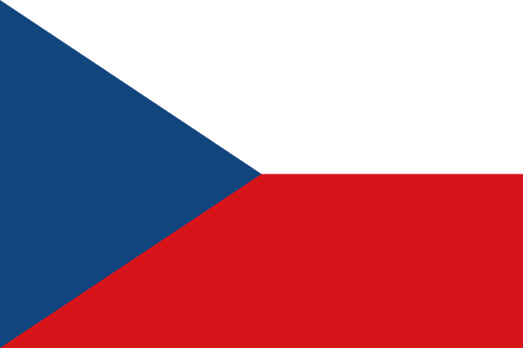



Company development
Due to the exceptional results achieved on the local market, the AKAI product expansion in new markets in the region, starting with Bulgaria, Croatia and Slovenia in 2016, was successfully negotiated, continuing with Greece in 2017, in order to sign the contract for 4 new and important markets in February 2018 : Poland, the Czech Republic, Hungary and Slovakia.
As a result of the continuous development of new products on the market and the expansion of the customer portfolio, INTERVISION has managed to obtain exceptional financial results in recent years, both in terms of turnover and profit, summarized in the charts below:

Slide 8
Evolution of turnover in 2014-2017 (€) - excluding VAT

Slide 9
Profit evolution in 2014-2017 (€)

Slide 10
Repartition of customer portfolio by turnover in 2017 (€ 6,615,949)

Slide 11
The entire team of company specialists who professionally respond to import-export activities, trade correspondence, new product development, sales, invoicing, customer relations, etc. contributed to these results.

Slide 12
Nowadays...
Our team counts 7 employees, the logistics, distribution, service and accounting being outsourced.

Slide 13
Throughout the company's activity, since its inception, there have been no changes in the shareholder structure, the company being 100% owned by the sole shareholder, Dorin Ciobanu.

